Slide 1
AIRLINES TICKET BOOKING SYSTEM
Team Members: Khushi Arora (RA1911003010198)
Heena Rungta (RA1911003010207)

Slide 2
Abstract
Airlines Ticket Booking System is an application of Database Management System which is used for booking and schedule information This project Airline Ticket Booking System is to provide help for the user to book their flight tickets without visiting booking counter or to any other booking vendors This system provides options for viewing different flights available with different timings for a particular date and provides customers with the facility to book a ticket, modify or cancel a particular reservation but it does not provide the customers with details of the cost of the ticket.

Slide 3
It can also manage all the information about customers, booking inquiry reservation Users can view the status and schedule of a flight directly, from the online It also provides time to time current information related to airlines schedules. It tracks all the details about the airline’s booking, ticket booking. It can keep recording airline employee detail, daily attendance, and employee salary calculation.

Slide 4
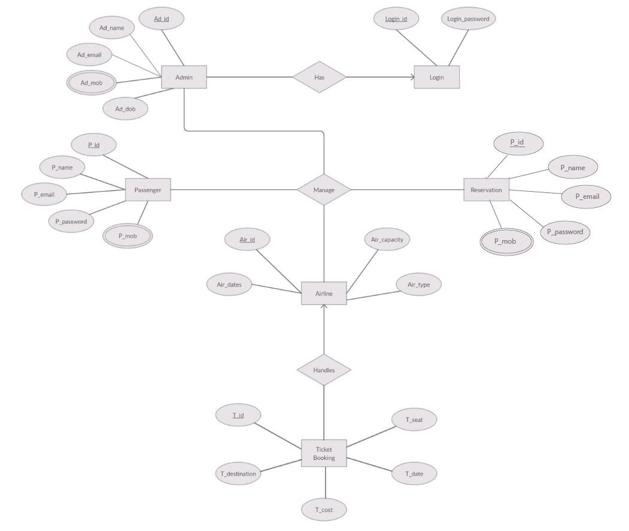
ER Diagram

Slide 5
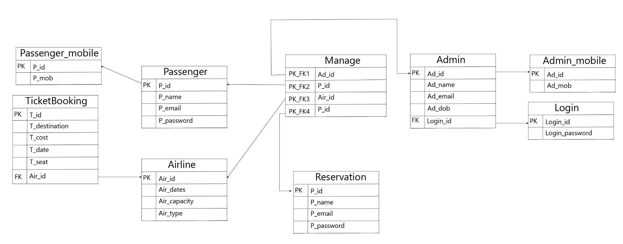
Relational Schema

Slide 6
Relational Schema
In the above relation schema 9 tables were made which were as follow:
Passenger mobile
Ticket booking
Passenger
Airline
Manage
Reservation
Admin
Admin Mobile
Login

Slide 7
Creating Tables

Slide 8
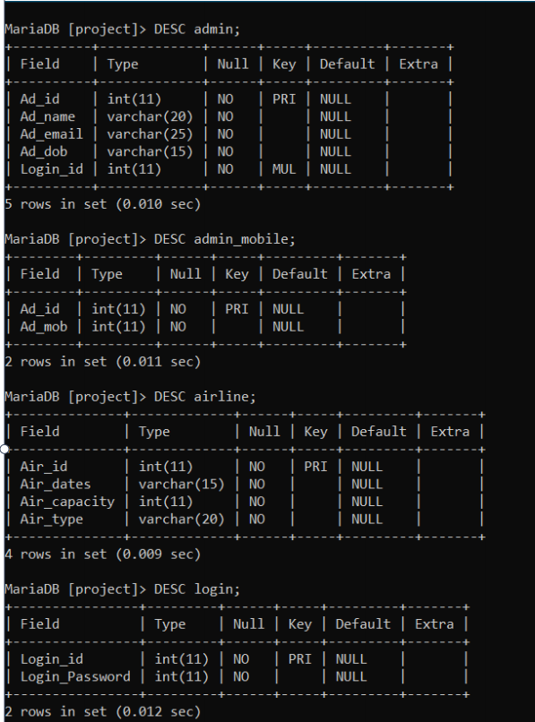

Slide 9
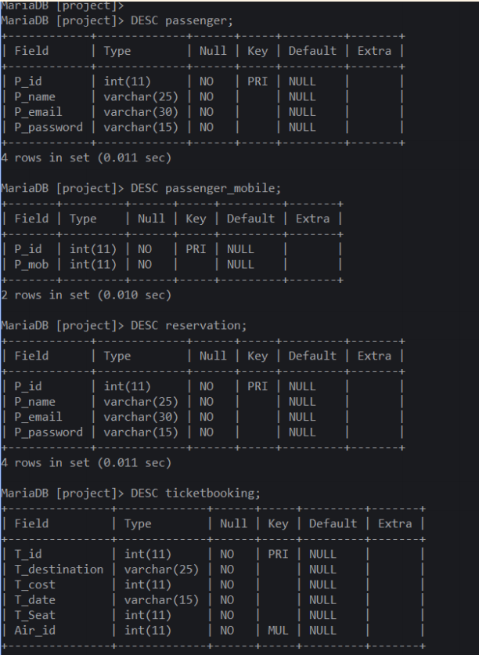

Slide 10
Insertions of values in the table
insert into Airline values('1' , '1-06-21' , '18 0', 'Private');
insert into Airline values('2', '2-06-21' , '10 0', 'Government');
insert into Airline values('3', '3-06-21' , '75', 'Private');
insert into Airline values('4', '4-06-21' , '200', 'Private');
insert into Airline values('5', '5-06-21' , '15 0', 'Government');
insert into TicketBooking values( '1111' , 'Goa', '5000', '1-06-21' ,'10 ','1' );
insert into TicketBooking values( '2222', 'Chennai', '7000', '2-06-21' ,'23','2');
insert into TicketBooking values( '3333', 'Mumbai', '9000', '3-06-21' ,'45','3');
insert into TicketBooking values( '4444', 'New Delhi', '15 000', '4-06-21' ,'17 ','4');
insert into TicketBooking values( '5555', 'Kolkata', '3500', '5-06-21' ,'26','5');

Slide 11
Insertions of values in the table
insert into Reservation values('11' , 'Nachiketa Choudhary', 'nachi@email.com','10 0300');
insert into Reservation values('12', 'Sachin Motwani', 'sachin@email.com','045045');
insert into Reservation values('13 ', 'Nandita Menon', 'nandita@email.com','870870');
insert into Reservation values('14', 'Shah Rukh Khan', 'srk@email.com','500500');
insert into Reservation values('15 ', 'Kuldeep Yadav', 'kull@email.com','900400');
insert into Passenger values('11' , 'Nachiketa Choudhary', 'nachi@email.com','10 0300');
insert into Passenger values('12', 'Sachin Motwani', 'sachin@email.com','045045');
insert into Passenger values('13 ', 'Nandita Menon', 'nandita@email.com','870870');
insert into Passenger values('14', 'Shah Rukh Khan', 'srk@email.com','500500');
insert into Passenger values('15 ', 'Kuldeep Yadav', 'kull@email.com','900400');

Slide 12
Insertions of values in the table
insert into Passenger_mobile values( '11' , '8796767599');
insert into Passenger_mobile values( '12', '9765236798');
insert into Passenger_mobile values( '13 ', '7698764567');
insert into Passenger_mobile values( '14', '9746487676');
insert into Passenger_mobile values( '15 ', '6784648076');
insert into Admin values('1' , 'Deepak Hooda','deepak@admin.com','12-12-01' ,'123456');
insert into Admin values('2', 'Suresh Raina','suresh@admin.com','15 -12-02','999111' );
insert into Admin values('3', 'Mahesh Bhatt','mahesh@admin.com','20-11-01' ,'200300');

Slide 13
Insertions of values in the table
insert into admin_mobile values ('1' ,'7654896587');
insert into admin_mobile values ('2','5456897377');
insert into admin_mobile values ('3','9944467855');
insert into login values('123456','065065');
insert into login values('999111' ,'222333');
insert into login values('200300','500700');

Slide 14
DDL With Constraints
In SQL, DDL means Data Definition Language. The SQL Server DDL commands are used to create and modify the structure of a database and database objects.

Slide 15
Set operations
Here are four major types of SQL operators, namely:
Union
Union all
Intersect
Minus

Slide 17
Aggregate operations
The following are the most commonly used SQL aggregate functions:
AVG – calculates the average of a set of values.
COUNT – counts rows in a specified table or view.
MIN – gets the minimum value in a set of values.
MAX – gets the maximum value in a set of values.
SUM – calculates the sum of values.

Slide 18
Joins:
A join clause in SQL – corresponding to a join operation in relational algebra – combines columns from one or more tables into a new table

Slide 19
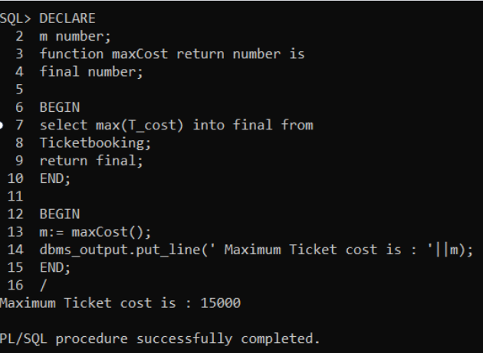
PL/SQL
To find max cost of tickets:

Slide 20
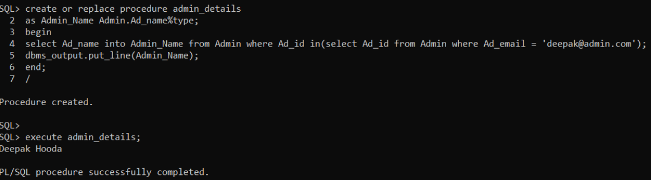
Procedure to find the name of the admin with email, deepak@admin.com

Slide 21
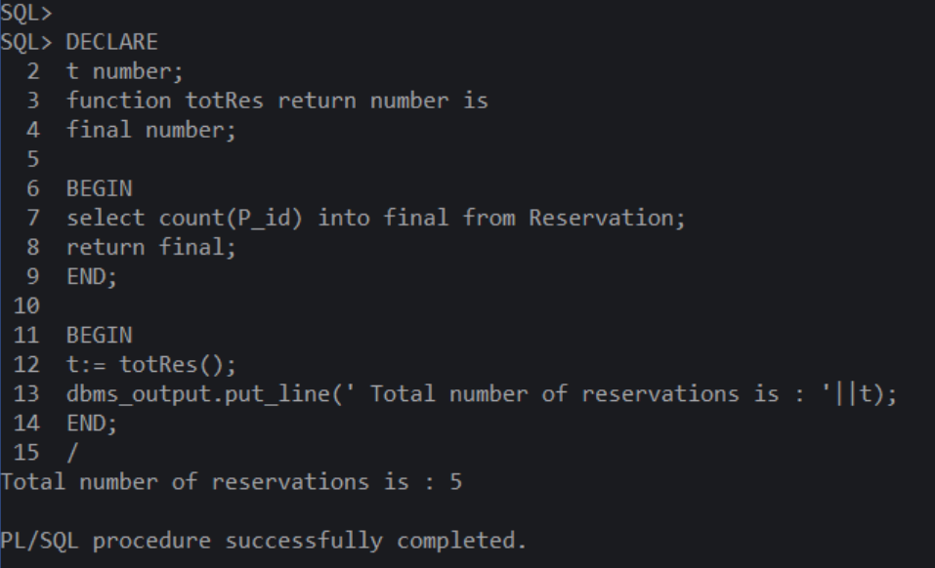
To find the total number of reservations

Slide 22
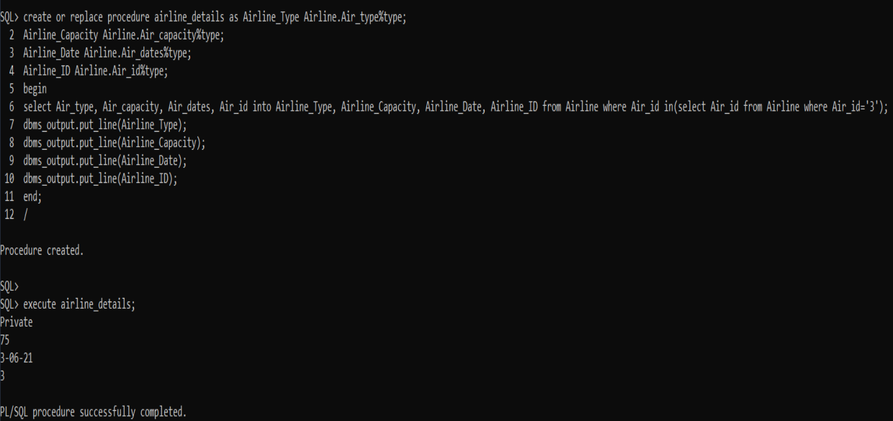
Procedure to display details of the airline with ID as 3.

Slide 23
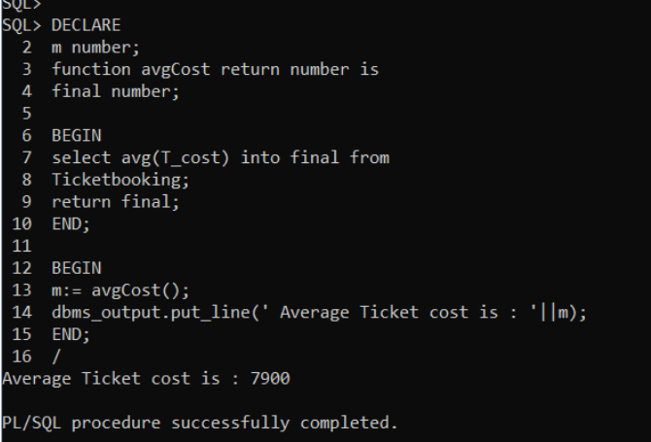
To find the average cost of tickets:

Slide 24
THANK YOU!

